Slide 1
Statistics for linguists
2023-12-06
Chi-squared test, loglinear models

Slide 2
From last class
Linear models
Errors and residuals
Sum of squares
ANOVA

Slide 3
For this class
Directed acyclic graphs (introduction)
Chi-squared test
Loglinear model / logistic regression

Slide 4
Loglinear regression

Slide 6
Counts & contingency tables
A lot of statistical information comes from counts (e.g. frequency of words in different texts)
The data are usually presented in a contingency table.
Data from Matthew Dryer (1992)
OV = Object-Verb words order / VO = Verb-Object word order
Postp = positions / Prep = prepositions
H1:postpositions are associated with OV word order and prepositions are associated with VO order
Dryer, Matthew S. 1992. The Greenbergian Word Order Correlations. Languages 68:1, 81-138.

Slide 7
Contingency table (word order associations)
 | OV | VO
Postp | 107 | 12
Prep | 7 | 70
adpos <- matrix(c(107,12,7,70),ncol=2,byrow=TRUE)
rownames(adpos)<-c("PostP","Prep")
colnames(adpos)<-c("OV","VO")
adpos
Dryer, Matthew S. 1992. The Greenbergian Word Order Correlations. Languages 68:1, 81-138.

Slide 8
Counts and probabilities
These are observed frequencies
We now need a model that predicts the expected frequencies
Using these data, what is the probability of a random language from this sample having OV?
Dryer, Matthew S. 1992. The Greenbergian Word Order Correlations. Languages 68:1, 81-138.

Slide 9
Counts and probability
wordorder <- cbind(c(107, 7), c(12, 70))
rownames(wordorder) <- c("Postp", "Prep")
colnames(wordorder) <- c("OV", "VO")
wordorder <- rbind(wordorder, c(114,82))
wordorder <- cbind(wordorder, c(119,77,196))
rownames(wordorder) <- c("PostP", "Prep", "Column Total")
colnames(wordorder) <- c("OV", "VO", "Row total")
wordorder

Slide 10
Expected Frequency
Raw total (Postp = 119, Prep = 77)
Column total (OV = 114, VO = 82)
Grand total = 196
Expected = (Raw total * Column total) / Grand total
Dryer, Matthew S. 1992. The Greenbergian Word Order Correlations. Languages 68:1, 81-138.

Slide 11
Expected frequency
The expected frequency refers to what the values would be if VO/OV and Postp/Prep were independent.
 | OV | VO
Postp | (114*119)/196 | (82*119)/196
Prep | (114*77)/196 | (82*77)/196
E <- cbind(c((114*119)/196, (114*77)/196),
c(82*119/196,(82*77)/196))
rownames(E) <- c("Postp", "Prep")
colnames(E) <- c("OV", "VO")
E

Slide 12
Expected frequency
What we’ve done is created a hypothetical “null distribution” against which we can measure how surprising our actual data are.
 | OV | VO
Postp | 69.21429 | 49.78571
Prep | 44.78571 | 32.21429

Slide 13
Expected frequency vs. real frequencies
What we’ve done is created a hypothetical “null distribution” against which we can measure how surprising our actual data are.
 | OV | VO
Postp | 69.21429 | 49.78571
Prep | 44.78571 | 32.21429
 | OV | VO
Postp | 107 | 12
Prep | 7 | 70

Slide 14
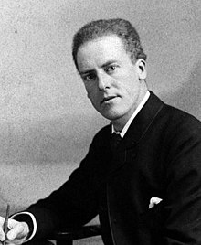
Chi-squared test
The classical way of doing this is Karl Pearson’s chi-squared test.
https://upload.wikimedia.org/wikipedia/commons/2/21/Karl_Pearson_2.jpg

Slide 15
E <- cbind(c((114*119)/196, (114*77)/196),
c(82*119/196,(82*77)/196))
rownames(E) <- c("Postp", "Prep")
colnames(E) <- c("OV", "VO")
E
E.df <- melt(E)
colnames(E.df)<-c("Adposition", "Verb.Object", "Expected.Frequency")
E.df$Observed.Frequency <- c(107,7,12,70)
E.df
Putting expected and observed data in the same data set
E.df$oe <- ((E.df$Observed.Frequency - E.df$Expected.Frequency)^2) / E.df$Expected.Frequency
sum(E.df$oe)

Slide 16
Chi-squared test and p values
Is this number big?
What is the critical value of the chi-squared test?
To calculate this, we need the degrees of freedom and the cut off area you want.
R = number of rows
C = number of columns

Slide 17
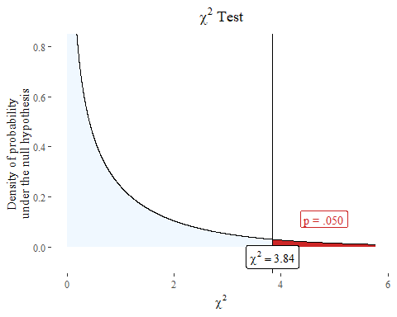
Chi-squared test and p-value
We have another hypothetical distribution based like the t distribution.

